Slide 1
Azure Solution Alignment Workshop
Azure Subscription Model Design Workshop

Slide 2
High-level agenda
Azure scaffold
Subscription overview
Design and requirements
Azure Resource Model
Tags
Azure RBAC (role-based access control)
Azure Resource Manager resource locks
Azure Resource Manager policy management
Key decisions and next steps

Slide 3
Subscription Discovery & Discussion
Existing Subscriptions?
EA Agreement? If so who, how managed
Least Privilege?
Separation of Duties?
How many
Purpose
Naming Standards – anywhere? Consistent?
Anything in Azure Service Management (ASM)? ARM?
Tagging
How used – even if in AWS
Any Standards?
Chargebacks, Showbacks?

Slide 4
Azure scaffold

Slide 5



The Azure enterprise scaffold
Azure Resource policy
& audit
Azure scaffold
Naming standards
Resource tags
Resource locks
Pillars
Resource groups
Azure automation
Core
Foundation
Role-based access controls
Azure Security Center
Subscriptions
Account/enterprise agreement
aka.ms/Azure/Scaffold

Slide 6
The foundation – Enterprise enrollment
…and departments, accounts, and most importantly—subscriptions.
You may be tempted to skip or shorten this step! DON’T!
The repercussions are lasting and will impact your satisfaction with Azure
Enterprise enrollment

Department A
Department B
Account A
Account B
Account C
Subscription 1
Subscription 2
Subscription 3
Subscription 4
Finance/Business
Concerned with how costs can be monitored, rolled up, and ultimately correctly allocated
Security/Risk Mgmt.
Concerned about everything …but mostly looking to ensure that appropriate controls are in place
Technology Pro
Concerned with how they will manage the growth and where to put resources

Slide 7
Subscriptions are the cornerstone
…Determine the model you will follow before anything else!
Technical requirements
App
Business requirements
Lifecycle
Security requirements
Dept.
Scalability requirements
aka.ms/Azure/Subscriptions
Notes:
http://aka.ms/Azure/Subscriptions

Slide 8




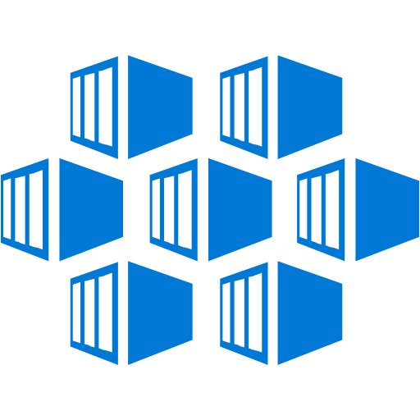


The pillars – Naming standards
Allow easier identification of resources in the Portal, logs, etc.
Allows easier breakout of data in Dashboards and Billing
Enables scripting and automation by having standard conventions
Enables Microsoft to better help the customer! (not having 100 subscriptions named Microsoft Azure Enterprise)
Microsoft has published great guidance here: https://azure.microsoft.com/en-gb/documentation/articles/guidance-naming-conventions/

Slide 9
The pillars – Azure Resource Manager policies
…enable you to address many concerns.
Finance/Business
How can I be notified when costly resources are created?
How can I ensure that new resources are identified with common information like “Cost Center?”
{
"if" : {
<condition> | <logical operator>
},
"then" : {
"effect" : "deny | audit | append“
}
}
Security/Risk Mgmt.
How do I ensure we don’t violate data sovereignty rules?
How can I find out when resources are created so I can verify they follow our Security Policies?
Technology Pro
How can ensure my subscriptions have only allowed resources?
Can I make sure developers follow our established naming conventions?
Link to Azure Resource Manager policy introduction: https://azure.microsoft.com/en-us/documentation/articles/resource-manager-policy/

Slide 10
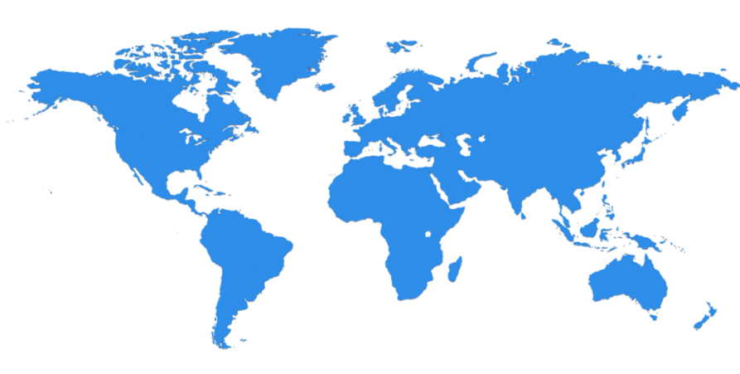

The pillars – Azure Resource Manager policies
Scenario
Bob
LRS
GRS
GRS-RA
Storage Resource Policy
Dan
Alice

Slide 11

The core – Resource groups, tags, and RBAC
Finance/Business
Need to be able to break out costs by various dimensions such as customer, cost center, environment
Technology Pro
Wants to maximize the use of a subscription (multiple apps)
Wants to know who owns certain resources
Wants to deploy and manage apps as a unit
Security/Risk Mgmt.
Want to ensure that those with “need” have access to resources
Want to design for “least privilege access” to ensure that the access is appropriate to the role
Create roles with appropriate permissions
Resources in a RG should be tagged as needed
Always Tag!
Owner
Dept.
Environment
Best practices on using Resource Tags: https://azure.microsoft.com/en-us/documentation/articles/resource-group-using-tags/
Custom RBAC Roles: https://azure.microsoft.com/en-us/documentation/articles/role-based-access-control-custom-roles/

Slide 12
The core – Res. locks, automation, Security Ctr.
Finance/Business
Not much to make finance happy here, but hey, what can you do?
From the business POV, these capabilities increase stability and availability
Smart use of automation allows business to be more flexible to demand
Technology Pro
Ensures stability of subscriptions by locking key resources from deletion or modification
Allow Technology Pros to create libraries of reusable code to manage their environments
Ensure that new resources aren’t accidently exposing the company’s information
Security/Risk Mgmt.
Gives the security and risk management teams the ability to see where they are vulnerable and how to address

Slide 13




The Gooey Center – Core Network
Technology Pro
Ensures that when resources are deployed, owners won’t inadvertently open up vulnerability
By setting up Network and security first, you can have a solid starting point
Will work with “VNET Peering” capability
Security/Risk Mgmt.
Enables a core set of initial NSG rules to be enabled BEFORE workloads are deployed providing a secure foundation
Provides a separation of internally focused workloads and externally focused workloads
Allows for additional appliances in the environment for additional protection
Internal VNET
Subnet 1
Subnet 2
External VNET
Subnet 1
Subnet 2

Slide 14
Azure Naming Conventions

Slide 15
The pillars – Naming standards
Allow easier identification of resources in the Portal, logs, etc.
Allows easier breakout of data in Dashboards and Billing
Enables scripting and automation by having standard conventions
Enables Microsoft to better help the customer! (not having 100 subscriptions named Microsoft Azure Enterprise)
Aka.ms/Azure/Naming

Slide 16
Naming conventions
Importance
Consideration
Requirements
Describes type of resource in the subscription
Places the naming pattern in an order that allows easier application level grouping for potential showback/chargeback billing
Automation
Some resource names are:
Constrained unique across entire Azure
Constrained by length
Constrained to alpha-numeric
Constrained unique within account
Cannot include upper case characters
Cannot contain offensive or forbidden substrings
Ensure:
Unique Azure naming
Case sensitivity requirements
Application association
Environment association
Region association
Instance association
Object association
aka.ms/Azure/Naming
Notes:
Some resource name constrained unique across entire Azure. http://aka.ms/Azure/Naming
E.g. SQL Server Name, Storage Account Name, etc. must be unique across Azure not just subscription
Some resource name constrained by length
E.g. Search Service is constrained 2 to 15 characters
Some resource name constrained to alpha-numeric
E.g. Storage Account Name cannot have dash, dots, etc.
Some resource name constrained unique within account
E.g. Storage Table Name must be unique within Azure subscription account
Some resource names cannot be upper characters
E.g. Storage account names must be all lower case
Ensure unique Azure naming
Ensure case sensitivity requirements
Ensure application association
Ensure environment association
Ensure region association
Ensure stack association
Ensure instance association
Ensure object association
Place the naming pattern in an order that allows easier application level grouping for potential showback/chargeback billing

Slide 17
Naming convention example
1. Divide the naming into segments
2. Create abbreviations for environments and resources (VMs and objects)
Segment A | Segment B | Segment C | Segment D
5 chars – Company identifier prefix plus location | 2-3 chars -Target or resident environment plus optional version | 3 chars Azure Resource Type: VM or object | 3 chars - Numeric sequence for deployment
Environments | VMs | Objects
PD: Production | ADC: Azure Domain Controller | CLS: Cloud Service
NP: Non-production | SDB: Azure SQL Database | ILB: Internal Load Balancer
DV: Development | WER: Azure Web Role | STA: Storage Account
QA: Quality assurance | IVM: Generic IaaS VM | VNT: Virtual Network
3
Segment A: Contoso
MCD
Segment B: Non-Production + Version
NP1
Segment C: VM-Azure SQL Database
SDB
Segment D: VM-SQL Deployment 3:
003
MCDNP1SQL003

Slide 18
Azure subscription overview

Slide 19
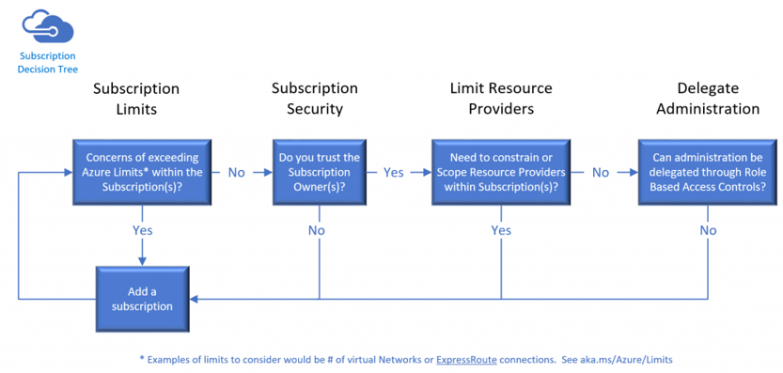
Subscription principles
Subscriptions are…
The first top level container you create
Equipped to support RBAC delegation
A billing unit
Logical limits of scale
Considerations
Subscriptions do not cost anything
Each subscription has its own admins, although a single account can be an admin in multiple subscriptions
Subscriptions are global
Start with “Can we do this with one?”
Then justify adding more
aka.ms/Azure/Subscriptions aka.ms/Azure/Limits

Slide 20
Containers and resources
Subscription is the top-level container
Create resource groups in the subscription
Place resources within the resource groups

Slide 21
Azure Governance layers
Functional
Business Division
Geographic
Functional
Enterprise
Enterprise
Enterprise
Enterprise
Departments
[optional]
Finance
Marketing
Auto
Aerospace
North America
Europe
Accounts
Adi Krishnan
Ted Bear
Grace Ma
Joe Smith
Jane Doe
Lin Chi
Subscriptions
Project 1 Dev
Project 1 Test
Production Websites
Application 1
Application 2
Application 3
Project 1
Project 2
Project 3

Slide 22
Management portals
Portal | Location | Purpose
Enterprise portal | https://ea.azure.com/ | Manage access Manage accounts Manage subscriptions View price sheet View usage summary Manage usage & lifecycle email notifications Manage authentication types
Account portal | https://account.windowsazure.com | Edit subscription details Enroll in or enable preview features
Management portal | https://portal.azure.com https://shell.azure.com https://portal.azure.us Azure GOV | Provision/de-provision Azure services Manage Role Based Access on subscriptions Open support tickets for issues within the subscription
Mobile App | https://aka.ms/Azure/Mobile | Manage from Android or iPhone Can use Cloud Shell too

Slide 23
Subscription considerations
Management approach
Single team or distributed
RBAC
Separation of Duties
Security requirements
Data or network security
Environments - Sandbox, Dev, Test, UAT, Pre-Prod, Prod
Compliance standards, Least Privilege
Connectivity requirements
Single point of ingress?
Multiple regions?
Application requirements
Data flow
Compliance

Slide 24
Subscription per department (customer-managed)
Each department contains different types of environments (e.g. Prod, Non-Prod). Virtual Networks will wrap the different environments for traffic separation. Subnets will be created within each environment to establish required security isolation zones between applications.
Pros
Low ExpressRoute circuit costs
Simplified subscription management
No VNet subscription limit
Cons
Granular RBAC model required
Subscription limit issues in cores, storage, NSGs
Complex VNet addressing
Mistake in management will affect all environments

Slide 25
Subscription per environment (customer-managed)
Each environment contains the different types of applications. Virtual Networks will wrap the different applications for traffic separation. Subnets will be created within each environment to establish required security isolation zones among application tiers.
Pros
Shared ExpressRoute circuit model
Low VNet subscription limit issues (limit per 100th application)
VNet address spaces can be tailored per application
Cons
New ExpressRoute circuit required per 10th application, or ER premium
Granulated application RBAC model
Requires medium capacity planning
Max of 10 dedicated circuits per subscription, max of 100 applications

Slide 26
Subscription per application (customer-managed)
Each application contains the different tiers. Virtual Networks will wrap the different tiers for traffic separation. Subnets will be created within each tier to establish required security isolation zones.
Pros
Minimal subscription limit issues
Minimal capacity planning
Per application RBAC model
Cons
Increased network costs
Management complexity

Slide 27
Networking considerations
Enterprise enrollment
Department A
Department B
Account A
Account B
Account C
Subscription 1
Subscription 2
Subscription 3
Subscription 4
Region
Region
VNet 1
VNet 2
VNet 3
VNet 4
VNet 5
VNet 6
ExpressRoute circuit
ExpressRoute circuit
ExpressRoute circuit
ExpressRoute circuit
ExpressRoute circuit

Slide 28
Multiple subscriptions = Complexity
Purpose and objectives
Multiple Azure subscriptions mean:
Duplicate provisioning and management: IP Address space, network circuits, gateways, VNets, Subnets, NSGs, routing
More connectivity to manage
More security to manage
More identities to manage
Potentially more ExpressRoute circuits to buy
Multiple subscriptions are going to happen nevertheless—design for it as N+1 aka.ms/Azure/Subscriptions
Resource Groups
vs

Slide 29

Azure roles versus management
Active Directory
Azure Active Directory
Application
Customer manages
the OS and app config.
Customer provisions
and manages Azure object
OS
Virtual hardware
Physical hardware
Microsoft manages
the platform and SLA
Fabric

Slide 30
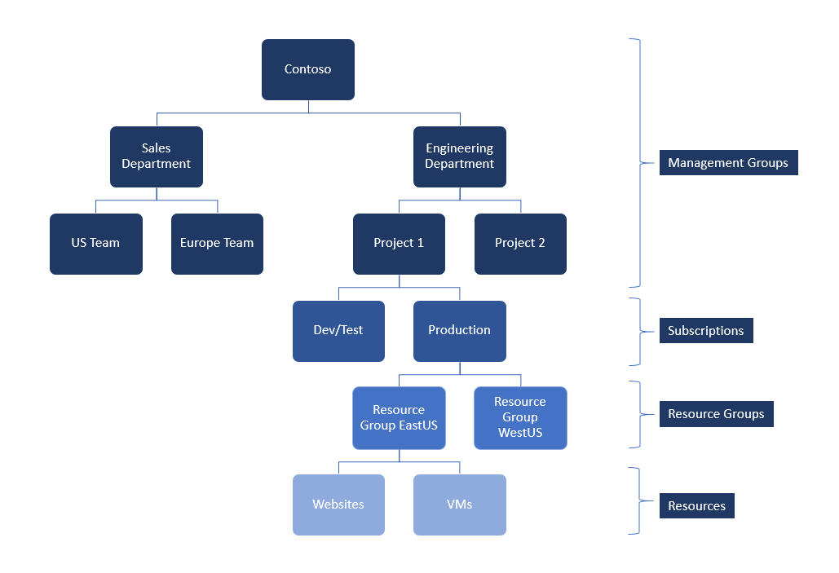
Azure Management Groups
Private Preview
Purpose
Organize Multiple Azure subscriptions
Manage
Access
Policy
Costs
Compliance
Trust with Azure AD
Trust a single Azure AD Tenant
NOTE: Policies are NOT enforced across directories
aka.ms/Azure/MgtGroups
Check link for current status
Notes:
Read up on this. The current understanding is that this will eventually replace the EA portal and thus be entirely integrated into the Azure Portal. So while this is mainly FYI, it is also important for planning. It is already showing hints when you do filtered searches by Scope and Management Groups are there.

Slide 31
Design and requirements

Slide 32
Enrollment design
Ensure you have at least two Enterprise Administrators
Are you going to use Departments?
Who will be the Account Owners?
They are the only ones that can create subscriptions
Is there a concern about restricting subscription creation?
Create functional accounts with split passwords

Slide 33
Subscription design guidance
Minimize # of subscriptions – start with one and justify additional based on requirements
Do not be afraid to have multiple approaches in the design
Take subscription limits into account
Plan for multiple subscriptions
Determine approach for Subscription Owners

Slide 34
Subscription design guidance
Identity management
Use Azure Active Directory for Azure Governance roles
Use built-in roles before custom roles
Create custom RBAC roles only if built-in does not exist
Use groups to assign RBAC versus users
ExpressRoute (ER)
Minimize # of subscriptions (take network requirements and ER boundaries into account)

Slide 35
Customer requirements drive structure
To be derived from customer requirements
Organization structure
Technical (e.g. network and security)
Functional

Slide 36
Subscription model design
Department, application, environment, other
Will you be using Ingress through Azure?
How granular will Azure Resource Management need to be?
Network, storage, compute, security, application

Slide 37
Customer requirements
Requirement | Description | Answer
Identity | Use preexisting Azure Active Directory from Office 365

Slide 38
Azure Resource Manager model overview

Slide 39
Azure Resource Manager
Describe
Deploy
Control
Resource group
Azure Resource Manager
Azure Resource Manager
App
Database
Compute
Network
Storage
Microsoft Azure Stack
Microsoft Azure
aka.ms/Azure/ARM
Notes:
http://aka.ms/Azure/ARM

Slide 40
Resource Providers
Resource providers are the API interfaces
Resource providers must be registered against a subscription before you can create resources
Subscription Owners automatically register resource provider as a resource it provisioned
User that does not have subscription owner rights cannot provision an Azure resource until the resource provider is registered
To register Microsoft Resource Providers in a subscription:
Select-AzureRmSubscription -Subscriptionname $SubscriptionName
$providers = @(Get-AzureRMResourceProvider -ListAvailable | Where ProviderNamespace -Match Microsoft)
foreach ($provider in $providers) {
Register-AzureRmResourceProvider -ProviderNamespace
$provider.ProviderNamespace

Slide 41
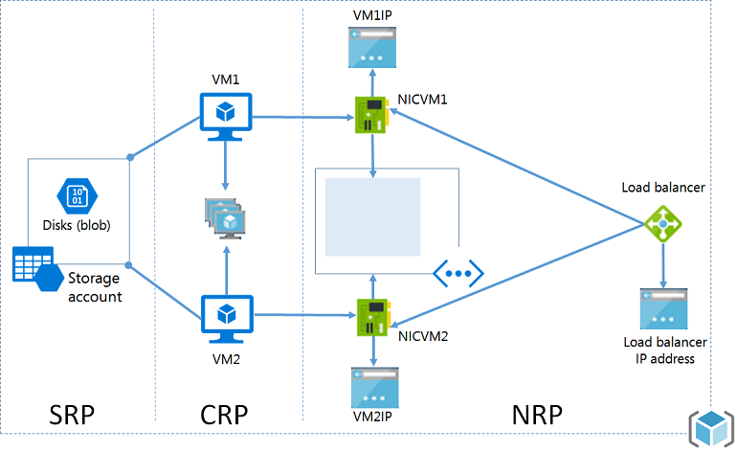
Azure Resource Manager
ARM with Resource Providers

Slide 42
Resource groups
Tightly coupled containers of multiple resources of similar or different types
Azure resources contained should have the same lifecycle
Every resource *must* exist in one and only one resource group
Resource groups can span regions
Nesting of resource groups not supported
Only Subscription Owners can create resource groups
RESOU
R
CE G
R
OUP

Slide 43
Resource group lifecycle
Question:
Should these resources be in the same group or a different one?

Slide 44
Resource groups and hierarchy
Subscription
Resource group
Resource
Resource
Resource group
Resource
Resource

Slide 45
Azure tags

Slide 46
Tag when there are more apps
Tag is your metadata store
Example:
Environment, e.g. dev/test/prod
Role, e.g. web/cache/db
Application name, e.g. CRM
Department, e.g. finance/retail/legal
Responsible party, e.g. Bob
Tags are essential for 3rd party management solutions

Slide 47
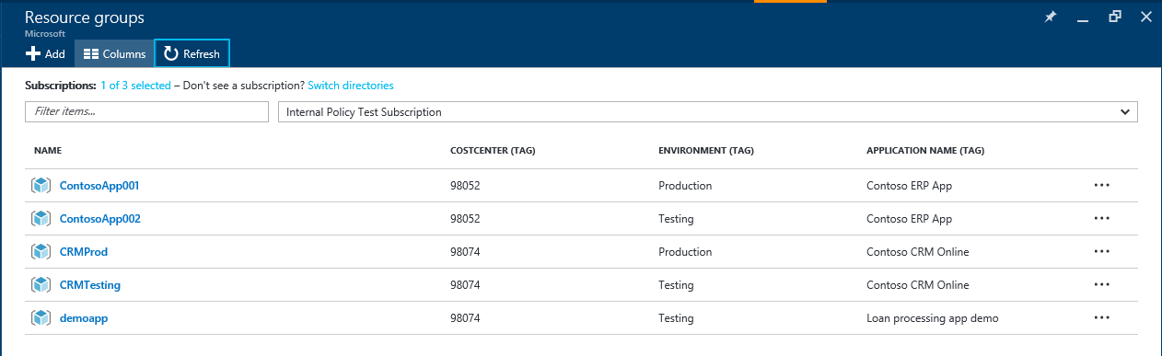
When you have tags
aka.ms/Azure/tags

Slide 48
Tags for billing and chargebacks
Determine groups based on consumption
Categorize costs based on…
Application
Department
Environments
Cost center
Retrieve information through…
CSV
RateCard API
Account or EA Portal

Slide 49
Enforce tags
Set tags in approved template
Set tags at resource group level
Use deny policy to enforce tags
Use audit policy to audit resources missing tags
Use append policy to append default tags
Use Azure Automation to apply tags

Slide 50
Azure RBAC overview

Slide 51
Role-based access control
Users
Authentication
& authorization
Groups
Azure Resources in resource groups
Service Principals
Azure Active Directory
Azure Subscription

Slide 52
Key RBAC concepts
Role definitions
Describes the set of permissions (e.g. read actions)
Can be used in multiple assignments
Role assignments
Associate role definitions with an identity (e.g. user/group) at a scope (e.g. resource group)
Always inherited – subscription assignments apply to all resources

Slide 53
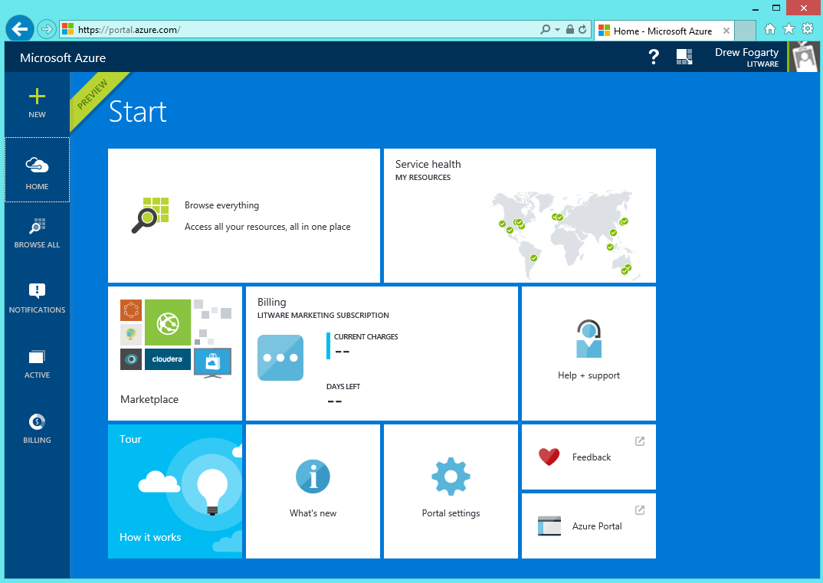
Least privilege as a model
Goal
Users can do the tasks their job requires, but no more than that
Best practices
Use the portal and ARM API
Assign the built-in role first
Follow least privileges
Use resource groups

Slide 54
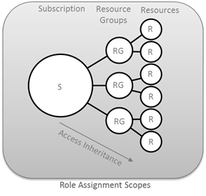
ARM hierarchy and RBAC roles
ARM provides a more granular RBAC model for assigning administrative rights at the resource level.
Owner
Can perform all management operations for a resource and its child resources including access management and granting access to others.
Contributor
Can perform all management operations for a resource including create and delete resources. A contributor cannot grant access to other.
Reader
Has read-only access to a resource and its child resources. A reader cannot read secrets.

Slide 55
RBAC

Slide 56
RBAC – Granular scopes
/subscriptions/{id}/resourceGroups/{name}/providers/…/sites/{site}
subscription level – grants permissions to all resources in the sub
resource group level – grants permissions to all resources in the group
resource level – grants permissions to the specific resource

Slide 57
Roles for Azure subscription resources
Three primary roles:
Owner, Contributor, Reader
Permissions on all Azure resources
40+ resource-specific roles:
Website Contributor, Virtual Machine Contributor, etc.
Permissions scoped to resources and actions typically required by customers
Will add more as new Azure resources come online
Custom roles:
Allow customers to take existing actions and create a custom RBAC role
Role must be loaded into each subscription
https://docs.microsoft.com/en-us/azure/active-directory/role-based-access-built-in-roles

Slide 58
Custom roles
Enhanced flexibility
Assignable to users, groups, or services at different scopes
Can be shared across multiple subscriptions in the same tenant

Slide 59
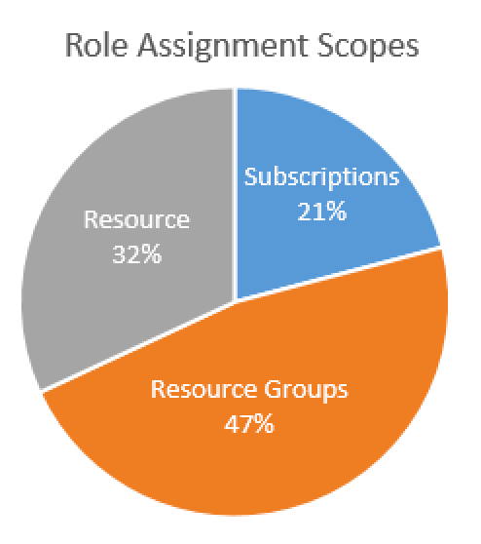
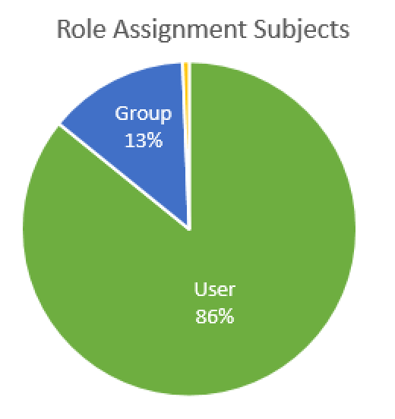
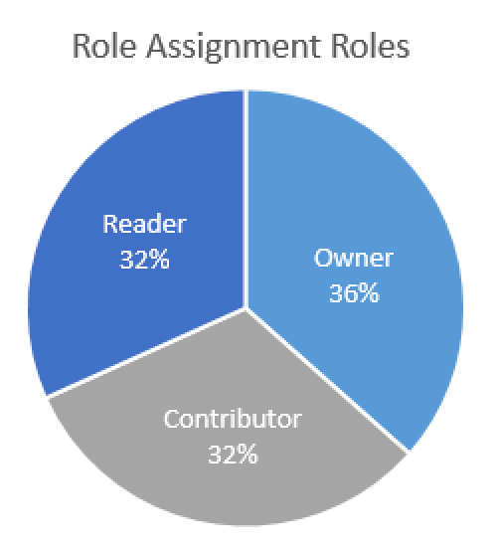
Azure RBAC usage

Slide 60
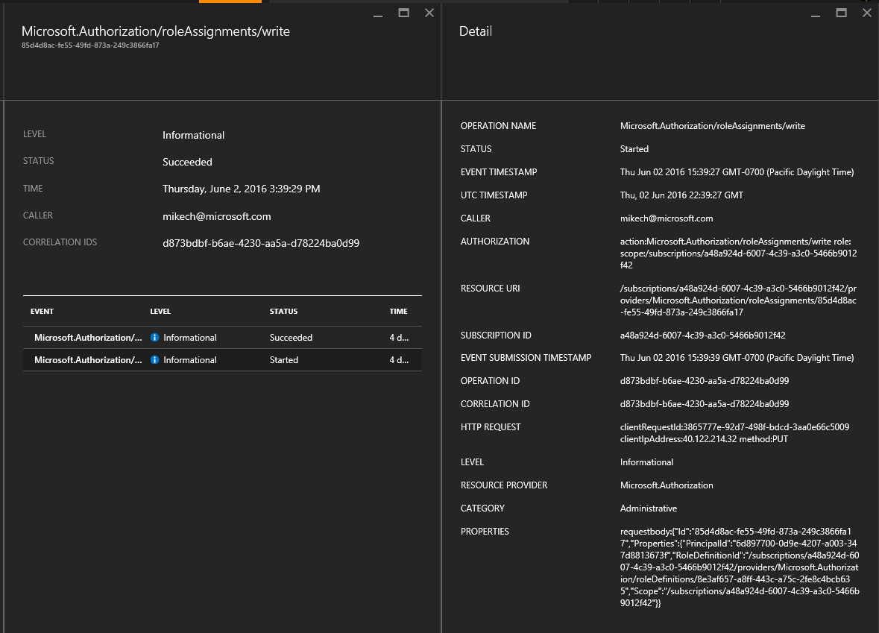
Audit history of RBAC activities

Slide 61
Assigning resource-specific roles
Requirements
Map existing organizational roles (web, DB…) to their cloud solutions
Many Azure resources that work together are peers in the same resource group
Virtual Machine and storage account, web app, and AppInsights
To fully manage a resource, a user may also need to manage its related peers
Best practice
Assign resource-specific role on the resource group
Alternative
Assign access to each resource individually

Slide 62
Key learnings from enterprise customers
Organizational accounts, not LiveIds
Resource groups, not subscriptions
Manage access using groups
Least privilege
Keep a tab on access changes

Slide 63
Azure Resource Manager resource locks

Slide 64
Resource locks
Accidents happen. Resource locks help prevent them ☺
Resource locks allow administrators to create policies which prevent write actions or prevent accidental deletion.

Slide 65
Key concepts
Resource lock
Policy which enforces a "lock level" at a particular scope
Lock level
Type of enforcement; current values include CanNotDelete and ReadOnly
Scope:
The realm to which the lock level is applied. Expressed as a URI; can be set at the resource group, or resource scope

Slide 66
Azure Resource Manager policy management

Slide 67
Azure Resource Manager policies – Key concepts
A default allow system
Described via policy definitions
Policy definitions can be created
To restrict the actions that can be performed or
Require the actions to meet a scenario before they can be performed
Policies are applied via policy assignments
Start small with policy configuration
aka.ms/Azure/Policies

Slide 68
Azure Resource Manager policies – Scenarios
Chargeback: Require departmental tags
Geo compliance: Ensure resource locations
Service curation: Select your service catalog
Convention: Enforce naming

Slide 69
Policy versus RBAC
Designed to work together
User must get past RBAC restrictions first
Policy can restrict the actions you can perform in addition to RBAC rights

Slide 70
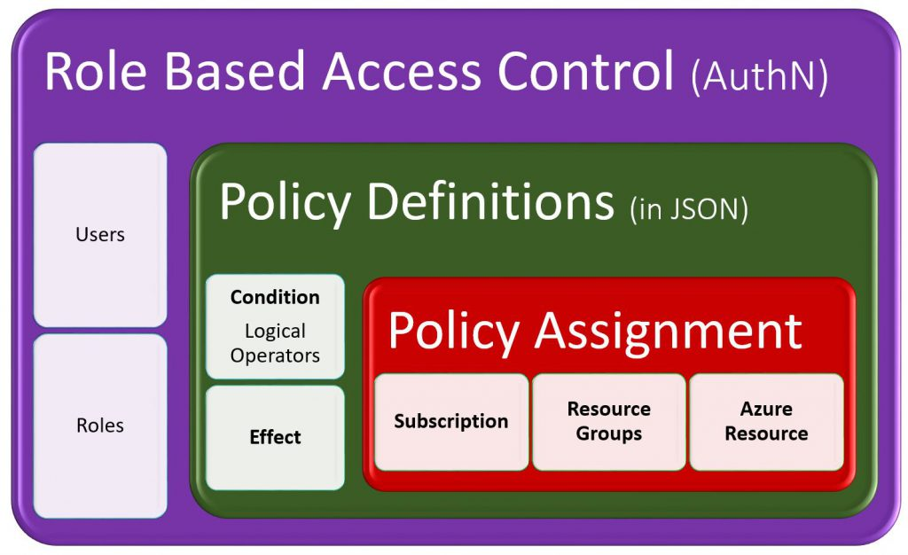
Putting it all together

Slide 71
Appendix

Slide 72
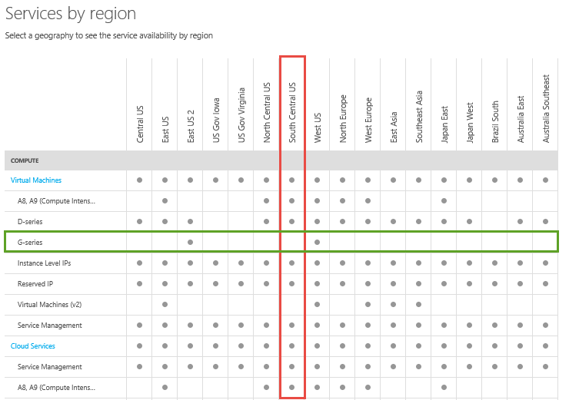
Correlating Azure products and regions
Features and regions
Ensure your feature is available in the region you wish to deploy
Preview and General Availability (GA)
Understand differences in support, costs, and available geographies
Special regions
MAG/China
Full suite of Azure services may not be currently available and have timelines for certification and availability

Slide 73
Subscription consumers
Customer-managed
When the Azure subscription is provisioned using the customer-owned account models described earlier in this document, where the customer organization deploys and manages Azure workloads on their own
Cloud Service Provider (CSP)-managed
When the Azure subscription is provisioned by Cloud Solution Provider who manages end customer Azure subscriptions

Slide 74
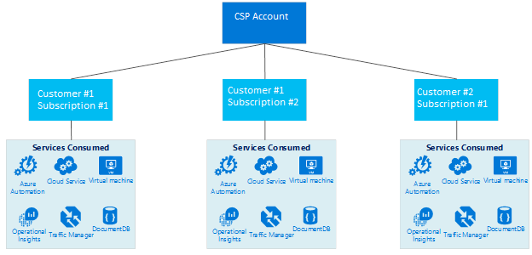
Subscriptions per customer (CSP-managed)
One or more subscription per specific customer where a separate service deployment for a given customer may be assigned a dedicated subscription.

Slide 75
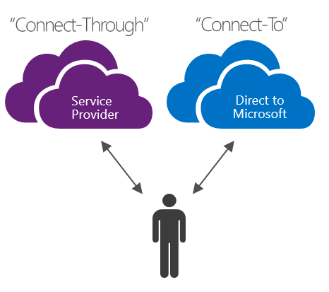
CSP subscription connection models
Service Providers will be required to connect their customers to their CSP Azure subscriptions in one of two ways:
“Connect-Through”
“Connect-To”
These models are heavily dependent on decisions around network connectivity and identity integration scenarios.

Slide 76
CSP-managed – “Connect-through”
Provider creates a direct connection between their datacenter and the provisioned customer Azure subscription using Site-to-Site on the provider’s network.
This connectivity scenario requires that the customer passes through a provider network to access CSP provisioned Azure subscription services, using a network connection that is created, owned, and managed by the service provider.
For these customers, it is assumed that the provider has a previously established tenant identity store, which would then be replicated into Azure Active Directory for management of their CSP subscription.

Slide 77
CSP-managed – “Connect-to”
Provider creates a direct connection between their datacenter and the provisioned customer Azure subscription using site-to-site VPN (or in the future over an Express Route connection) using the customer’s network.
This connectivity scenario requires that the customer connects directly through a customer network to access CSP provisioned Azure subscription services, using a direct network connection that is created, owned and managed either wholly or in part by the customer.
For these customers, it is assumed that the provider does not currently have a tenant identity store established and would assist the customer in replicating their current identify store into Azure Active Directory for management of their CSP subscription.

Slide 78
Built-in roles
Offer rich set of built-in roles to select from (40+)
Assignable to users, groups or services at different scopes
Can’t be modified
Top used built-in roles – Reader, Contributor, DevTest Labs User, Virtual Machine Contributor

Slide 79
Built-in roles
BUILT-IN ROLE | ACTIONS | NOT ACTIONS
Owner (allow all actions) | *
Contributor (allow all actions except writing or deleting role assignments) | * | Microsoft.Authorization/*/Write, Microsoft.Authorization/*/Delete
Reader (allow all read actions) | */Read

Slide 80
Who can view/create/update custom roles?
View - All built-in roles
Microsoft.Authorization/roleDefinition/read operation
Create/update – Owners of subscriptions, resource groups, and resources at that scope
Microsoft.Authorization/roleDefinition/write operation

Slide 81
Custom role - Sample role definition
{
"properties": {
"roleName": "Virtual Machine Contributor",
"type": "BuiltInRole",
"description": "Lets you manage virtual machines, but not access to them, and not the virtual network or storage account they’re connected to.",
"assignableScopes": [ "/" ],
"permissions": [
{
"actions": [
"Microsoft.Authorization/*/read",
"Microsoft.Compute/availabilitySets/*",
"Microsoft.Compute/locations/*",
"Microsoft.Compute/virtualMachines/*",
"Microsoft.Compute/virtualMachineScaleSets/*",
……..],
"notActions": [ ]
}
],
"id": "/subscriptions/c276fc76-9cd4-44c9-99a7-4fd71546436e/providers/Microsoft.Authorization/roleDefinitions/9980e02c-c2be-4d73-94e8-173b1dc7cf3c",
"type": "Microsoft.Authorization/roleDefinitions",
"name": "9980e02c-c2be-4d73-94e8-173b1dc7cf3c"
}

Slide 82
Ex: Virtual Machine Contributor
Actions | Access
Microsoft.Storage/storageAccounts/read | Read storage accounts
Microsoft.Storage/storageAccounts/listKeys/action | List storage account keys
Microsoft.Network/virtualNetworks/read | Read virtual networks
Microsoft.Network/virtualNetworks/subnets/join/action | Join virtual network subnets
Microsoft.Network/loadBalancers/read | Read load balancers
Microsoft.Network/loadBalancers/backendAddressPools/join/action | Join load balancer backend address pools
Microsoft.Network/loadBalancers/inboundNatRules/join/action | Join load balancer inbound NAT Rules
Microsoft.Network/publicIPAddresses/read | Read network public IP addresses
Microsoft.Network/publicIPAddresses/join/action | Join network public IP addresses
Microsoft.Network/networkSecurityGroups/read | Read network security groups
Microsoft.Network/networkSecurityGroups/join/action | Join network security groups
Microsoft.Network/networkInterfaces/* | Create and manage network interfaces
Microsoft.Network/locations/* | Create and manage network locations
Microsoft.Network/applicationGateways/backendAddressPools/join/action | Join network application gateway backend address pools
Microsoft.Compute/virtualMachines/* | Create and manage virtual machines
Microsoft.Compute/availabilitySets/* | Create and manage compute availability sets
Microsoft.Compute/locations/* | Create and manage compute locations
Microsoft.Authorization/*/read | Read authorization
Microsoft.Resources/subscriptions/resourceGroups/read | Read subscription resource groups
Microsoft.Resources/subscriptions/resourceGroups/resources/read | Read subscription resource groups resources
Microsoft.Resources/subscriptions/resourceGroups/deployments/* | Create and manage subscription resource group deployments
Microsoft.Insights/alertRules/* | Create and manage Insights alert rules
Microsoft.Support/* | Create and manage support tickets

Slide 83
Who can view/create/update custom roles?
Best practices
Organize resources to meet access management requirements
Grant access at resource group when appropriate
Benefits
More granularity
Aligns with resource-specific roles
Ongoing manageability
Marketing subscription
Example
Solution 1 resource group
Virtual Machine
Storage account
Solution 2 resource group
Virtual Machine
Storage account
SQL Server
Shared Infrastructure resource group
Virtual Network
Finance subscription
Solution A resource group
Web app
SQL Server

Slide 84
Example RBAC assignment
Requirements (example)
User needs to manage “web app A” and related resources such as “Application Insights B”
User shouldn’t manage “Virtual Machine C” or “Storage account D”
Best practice
Assign web app contributor and Application Insights Component Contributor role on ‘Solution 1 resource group’
Alternative: Two assignments
Contributor role on ‘Virtual Web App” and
Application Insights Component Contributor role on “App Insights B”
Marketing subscription
Solution 1 resource group
Web app A
Assigning role web app contributor on Solution 1 resource group
Conveys permissions on web apps and Application Insights instances in the resource group
Does not convey permissions on virtual machines or storage accounts
Application Insights B
Virtual Machine C
Storage account D

Slide 85
Azure Active Directory integration
Best practice
All organizational Azure subscriptions use the same Azure AD for access control
I.e., don’t have each subscription in the organization relying on its own default directory
Benefits
Manageability
Compliance
Litware Azure AD
Marketing subscription
Resource group 1
Resource
Resource
Resource group 2
Resource
Resource
Finance subscription
Resource group A
Resource
Resource

